Slide 1
DISTANCE MEASURE

Slide 2
DISTANCE MEASURE
Similarity is a measure of how much two data objects are alike.

Slide 3
DISTANCE MEASURE
Similarity is a measure of how much two data objects are alike.
Distance measure indicates the degree of dissimilarity between two items

Slide 4
DISTANCE MEASURE
Similarity is a measure of how much two data objects are alike.
Distance measure indicates the degree of dissimilarity between two items
Distance measure is applied to find the similarity

Slide 5
DISTANCE MEASURE
Similarity is a measure of how much two data objects are alike.
Distance measure indicates the degree of dissimilarity between two items
Distance measure is applied to find the similarity
Small distance -----→ indicates--→ High Degree of similarity
Large distance -----→ indicates-→ Small Degree of Similarity

Slide 6
Constraints imposed on Distance Measure
1. Negativity of Distance : The distance between two points cannot be negative.

Slide 7
Constraints imposed on Distance Measure
1. Negativity of Distance : The distance between two points cannot be negative.
2. Positivity of Distance : The distance between any two point is 0 if they have the same co-ordinates.

Slide 8
Constraints imposed on Distance Measure
1. Negativity of Distance : The distance between two points cannot be negative.
2. Positivity of Distance : The distance between any two point is 0 if they have the same co-ordinates.
3. Symmetry of Distance : The Distance between X and Y is similar as the distance between Y and X.

Slide 9
Constraints imposed on Distance Measure
1. Negativity of Distance : The distance between two points cannot be negative.
2. Positivity of Distance : The distance between any two point is 0 if they have the same co-ordinates.
3. Symmetry of Distance : The Distance between X and Y is similar as the distance between Y and X.
4.Triangular inequality of Distance : It States :
d(x,y) <= d(x,z)+d(z,y)

Slide 10
Euclidean Distance

Slide 11
L1-NORM
| X1-X2 | + | Y1 – Y2 | --→ Manhattan distance

Slide 12

L2-NORM
$\boxed{d=\sqrt{{\left(x_{1}−x_{2}\right)}^{2}+{\left(y_{1}−y_{2}\right)}^{2}}}$

Slide 13
L- INFINITY NORM
Max ( | x1 – x2|, |y1-y2|)

Slide 14
Example
Consider two points (9,7) and (5,10) in 2D Euclidean Space find Euclidean Distance Between Them.

Slide 15

L2- NORM
$\boxed{d=\sqrt{{\left(x_{1}−x_{2}\right)}^{2}+{\left(y_{1}−y_{2}\right)}^{2}}}$
=

Slide 16

L2- NORM
$\boxed{d=\sqrt{{\left(x_{1}−x_{2}\right)}^{2}+{\left(y_{1}−y_{2}\right)}^{2}}}$
= 5

Slide 17
L1 – norm
| X1-X2 | + | Y1 – Y2 | --→ Manhattan distance
= ?

Slide 18
L1 – norm
| X1-X2 | + | Y1 – Y2 | --→ Manhattan distance
= 7

Slide 19
L – infinity norm
Max ( | x1 – x2|, |y1-y2|)
= ?

Slide 20
L – infinity norm
Max ( | x1 – x2|, |y1-y2|)
= 4

Slide 21
JACCARD DISTANCE

Slide 22
JACCARD DISTANCE
It is used to find the distance between two sets

Slide 23
JACCARD DISTANCE
It is used to find the distance between two sets.
It is defined as : d(x,y) = 1- SIM (x,y)
SIM (x,y) = Jaccard Similarity-→ measures the closeness of two sets

Slide 24
Example
Consider two sets A= {1,2,3,4,5} and B= {1,2,4,6,7} Evaluate how similar A and B is and also find the Jacard Distance

Slide 25

Example
Consider two sets A= {1,2,3,4,5} and B= {1,2,4,6,7} Evaluate how similar A and B is and also find the Jacard Distance
Jaccard Similarity
$J\left(A , B\right)=\frac{∣A∩B∣}{∣A∪B∣}$

Slide 26
Example
Consider two sets A= {1,2,3,4,5} and B= {1,2,4,6,7} Evaluate how similar A and B is and also find the Jacard Distance
Jaccard Similarity
$J\left(A , B\right)=\frac{∣A∩B∣}{∣A∪B∣}$

Slide 27
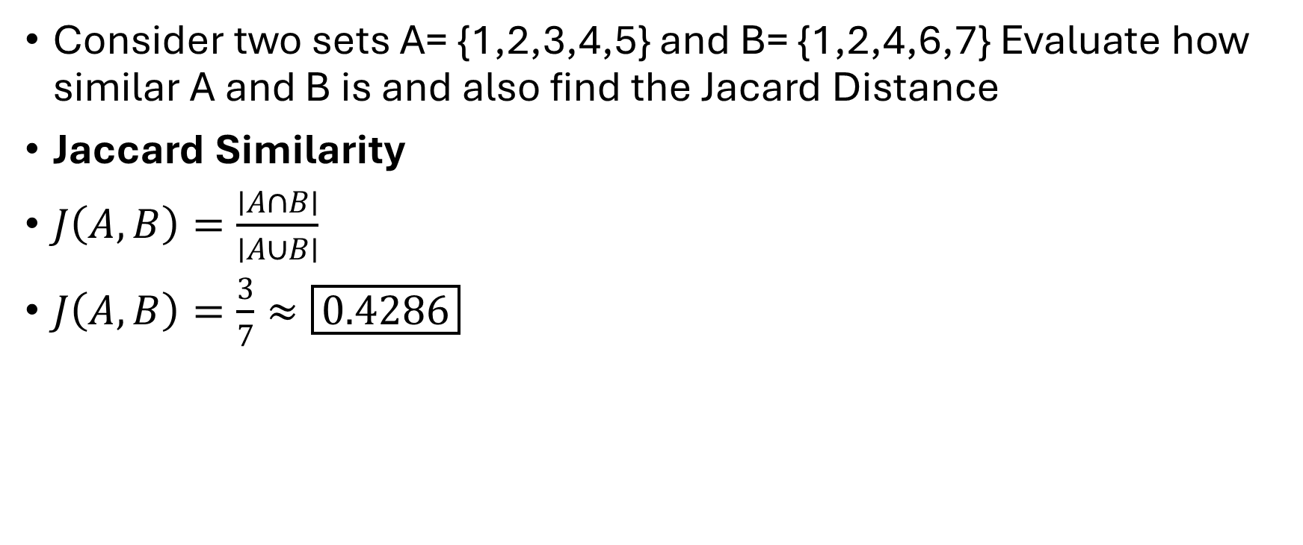
Example
Consider two sets A= {1,2,3,4,5} and B= {1,2,4,6,7} Evaluate how similar A and B is and also find the Jacard Distance
Jaccard Similarity
$J\left(A , B\right)=\frac{∣A∩B∣}{∣A∪B∣}$
$J\left(A , B\right)=\frac{3}{7}≈\boxed{0.4286}$

Slide 28
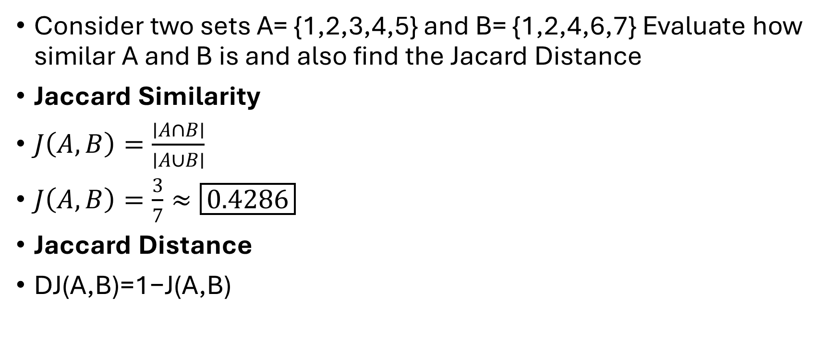
Example
Consider two sets A= {1,2,3,4,5} and B= {1,2,4,6,7} Evaluate how similar A and B is and also find the Jacard Distance
Jaccard Similarity
$J\left(A , B\right)=\frac{∣A∩B∣}{∣A∪B∣}$
$J\left(A , B\right)=\frac{3}{7}≈\boxed{0.4286}$
Jaccard Distance
DJ​(A,B)=1−J(A,B)

Slide 29
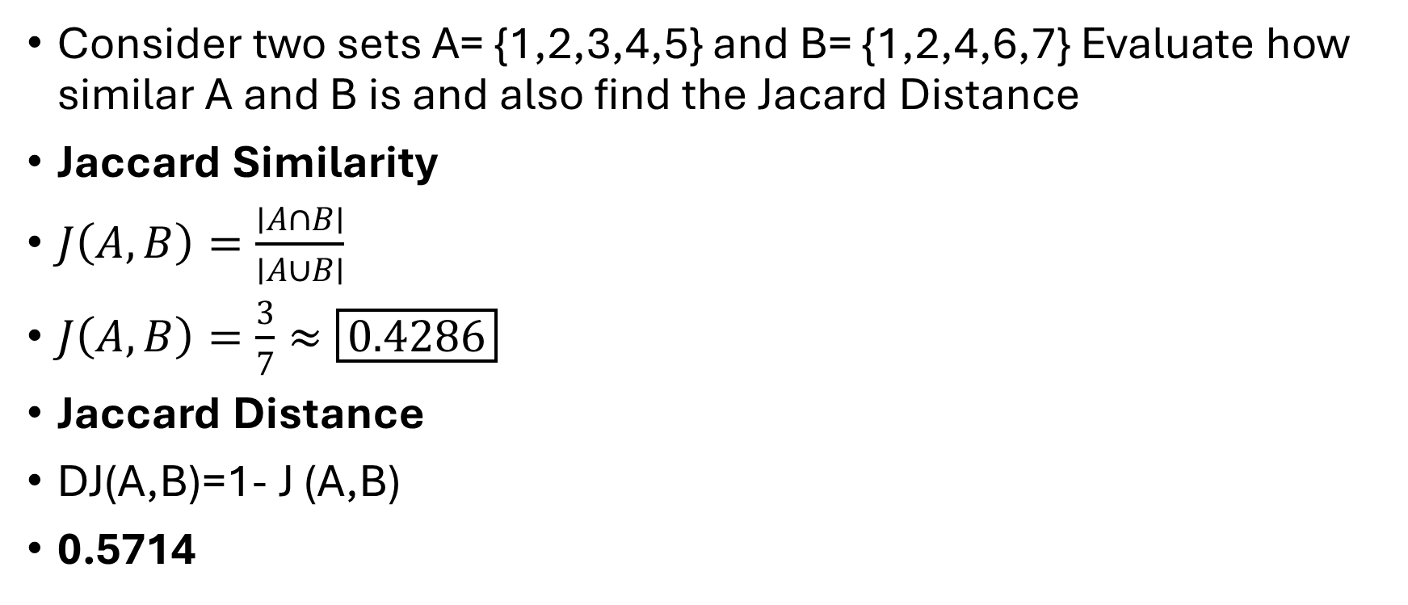
Example
Consider two sets A= {1,2,3,4,5} and B= {1,2,4,6,7} Evaluate how similar A and B is and also find the Jacard Distance
Jaccard Similarity
$J\left(A , B\right)=\frac{∣A∩B∣}{∣A∪B∣}$
$J\left(A , B\right)=\frac{3}{7}≈\boxed{0.4286}$
Jaccard Distance
DJ​(A,B)=1- J (A,B)
0.5714​

Slide 30
COSINE DISTANCE

Slide 31
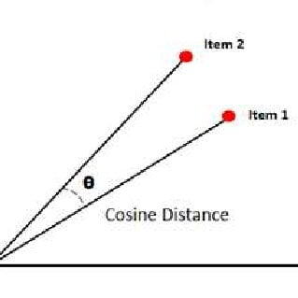
COSINE DISTANCE

Slide 32
COSINE DISTANCE
It is the angle between two vector.
Less angle --→ More Similar.
The angle ranges from 0 to 180
Used in recommendation system

Slide 33
Example
Consider the two vectors in Euclidean Space X= [1,2,-1] and Y= [2,1,1] calculate the cosine distance between x and y

Slide 34
Example
Consider the two vectors in Euclidean Space X= [1,2,-1] and Y= [2,1,1] calculate the cosine distance between x and y
STEP 1 : Calculate Dot Product
X . Y = ??

Slide 35
Example
Consider the two vectors in Euclidean Space X= [1,2,-1] and Y= [2,1,1] calculate the cosine distance between x and y
STEP 1 : Calculate Dot Product
X . Y = (1) (2) + (2) (1) + (-1) (1)
= 3

Slide 36
Example
Consider the two vectors in Euclidean Space X= [1,2,-1] and Y= [2,1,1] calculate the cosine distance between x and y
STEP 2: Calculate the magnitudes
|| X || = ??
|| Y || = ??

Slide 37
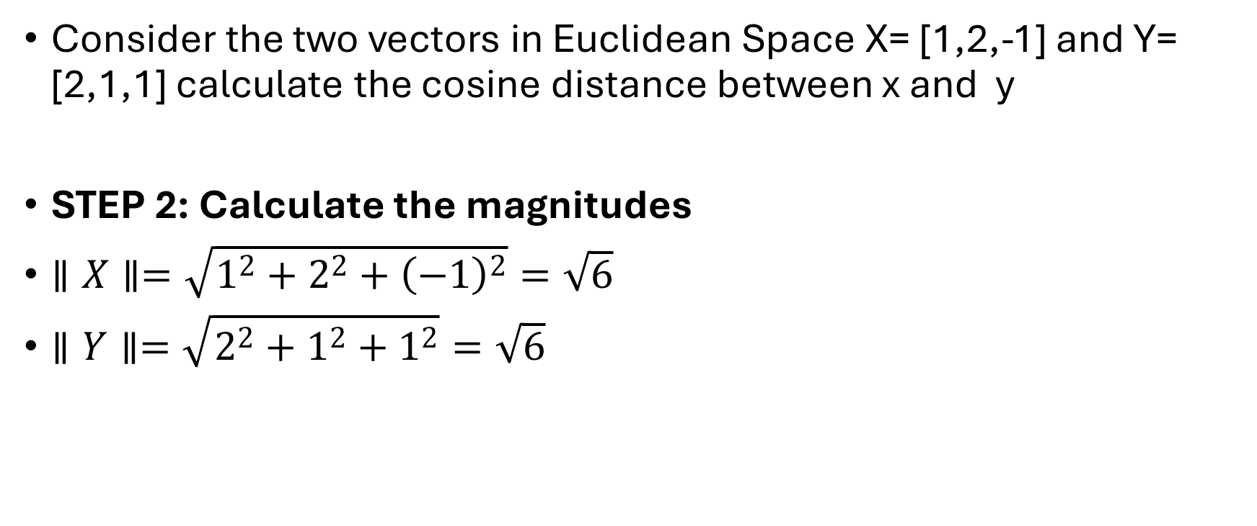
Example
Consider the two vectors in Euclidean Space X= [1,2,-1] and Y= [2,1,1] calculate the cosine distance between x and y
STEP 2: Calculate the magnitudes
$∥X∥=\sqrt{1^{2}+2^{2}+{\left(−1\right)}^{2}}=\sqrt{6}$
$∥Y∥=\sqrt{2^{2}+1^{2}+1^{2}}=\sqrt{6}$

Slide 38
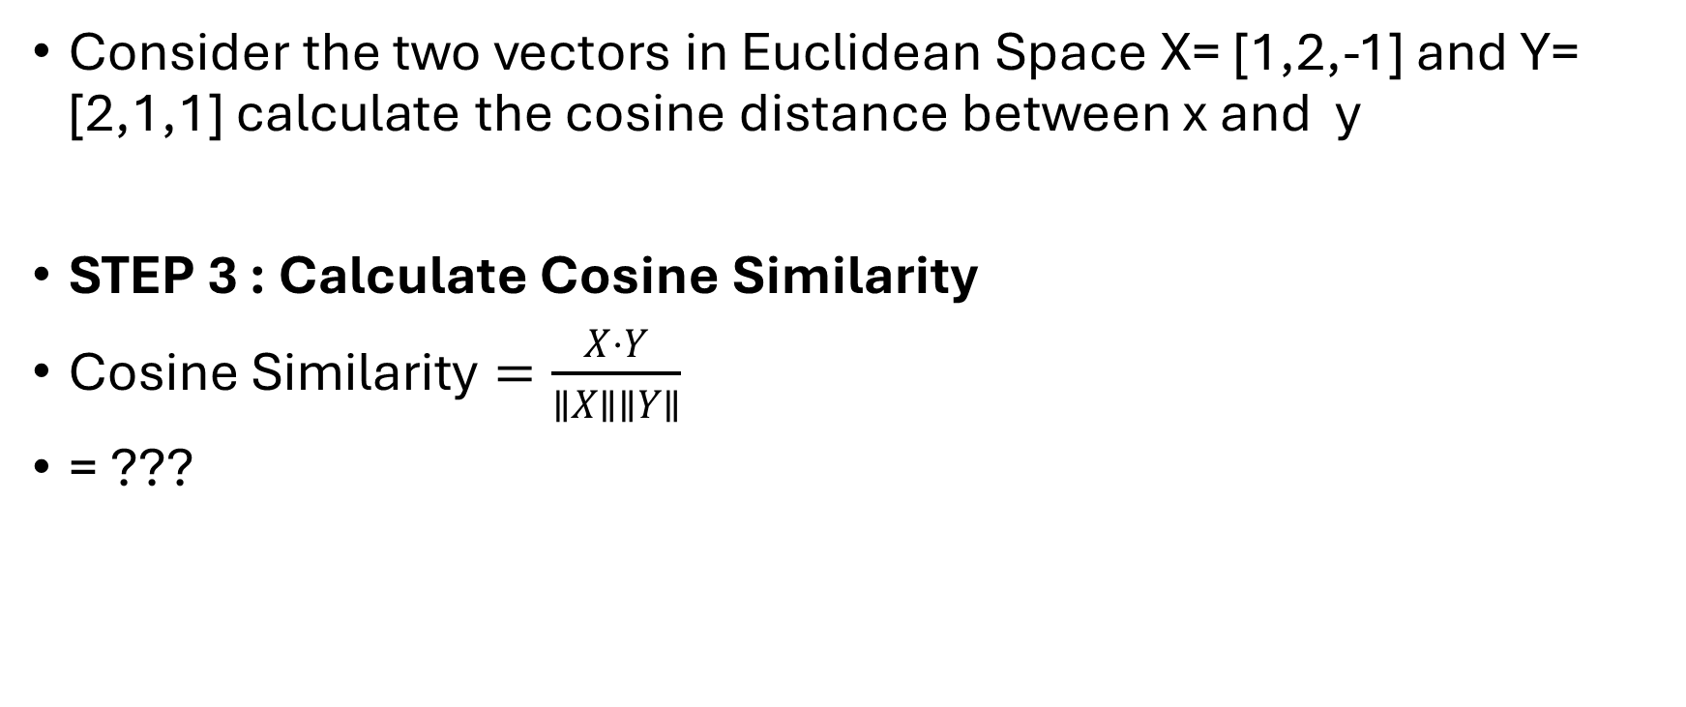
Example
Consider the two vectors in Euclidean Space X= [1,2,-1] and Y= [2,1,1] calculate the cosine distance between x and y
STEP 3 : Calculate Cosine Similarity
$\text{Cosine Similarity}=\frac{X⋅Y}{∥X∥∥Y∥}$
= ???

Slide 39
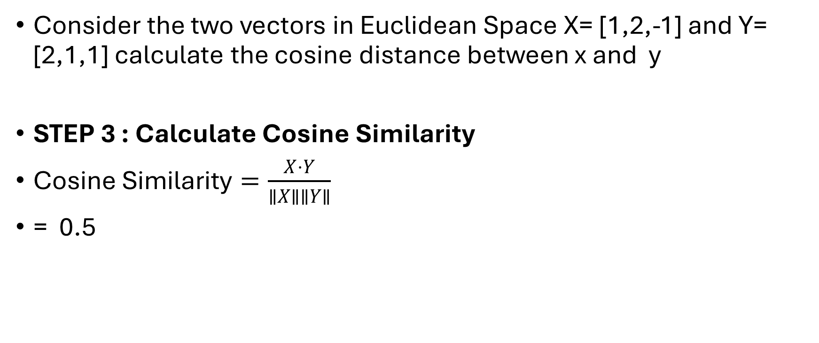
Example
Consider the two vectors in Euclidean Space X= [1,2,-1] and Y= [2,1,1] calculate the cosine distance between x and y
STEP 3 : Calculate Cosine Similarity
$\text{Cosine Similarity}=\frac{X⋅Y}{∥X∥∥Y∥}$
= 0.5

Slide 40
Example
Consider the two vectors in Euclidean Space X= [1,2,-1] and Y= [2,1,1] calculate the cosine distance between x and y
STEP 4 : Calculate Cosine Distance
Cosine Distance=1−Cosine Similarity
=??????

Slide 41
Example
Consider the two vectors in Euclidean Space X= [1,2,-1] and Y= [2,1,1] calculate the cosine distance between x and y
STEP 3 : Calculate Cosine Distance
Cosine Distance=1−Cosine Similarity
=0.5

Slide 42
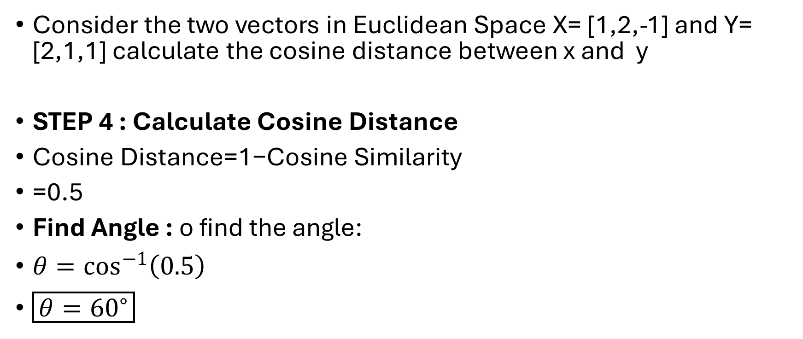
Example
Consider the two vectors in Euclidean Space X= [1,2,-1] and Y= [2,1,1] calculate the cosine distance between x and y
STEP 4 : Calculate Cosine Distance
Cosine Distance=1−Cosine Similarity
=0.5
Find Angle : o find the angle:
$θ=\cos^{−1}\left(0.5\right)$
$\boxed{θ={60}^{∘}}$

Slide 43

Final Answer
Cosine Similarity ($\cos{θ}$) = 0.5
Angle between vectors ($θ$) = $\boxed{{60}^{∘}}$
Cosine Distance = 0.5​

Slide 44
EDIT DISTANCE

